Slide 1


Spam Detection Using Machine Learning

Slide 2
Group Members
Name | ID
Ankit Kumar Singh | 181001001075
Saurav Tripathi | 181001001061
Sanchari Paul | 181001001081
Subhajit Gorai | 181001001150
Shahil Choudhary | 181001001074

Slide 3

Introduction
What is SPAM
Unwanted, unsolicited digital communication that gets sent out in bulk.
Illegal or unsolicited messages sent through to a large number of users.
Most spam is irritating and time-consuming, but some spam is positively dangerous to handle.

Slide 4
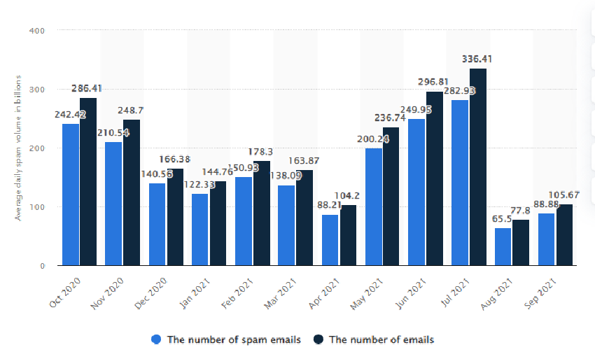
Spam Statistics
Average daily spam volume worldwide from October 2020 to September.

Slide 5
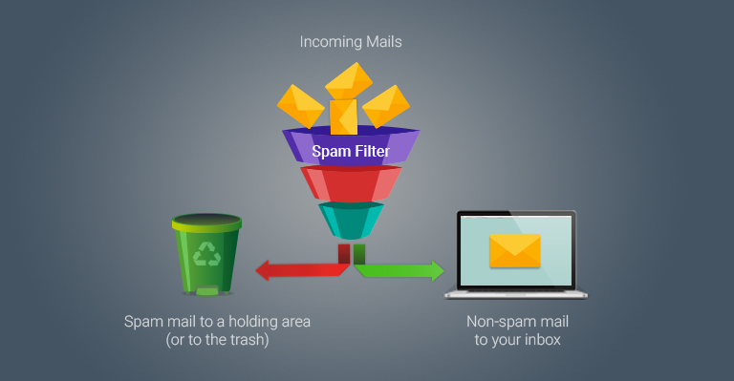
Ways of doing Spam Detection
Spam Filter - A program that is used to detect unsolicited and unwanted email and prevent those messages from getting to a user’s inbox.
Properties -
Filter must prevent spam from entering inboxes.
Able to detect the spam without blocking the ham.
Do not require any modification to existing e-mail protocols.
Easily incremental -
Spam evolve continuously
Need to adapt to each user

Slide 6
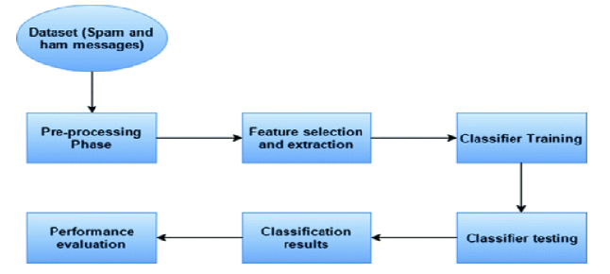
Possible Outcome
Being able to identify spam messages is a binary classification problem as messages are classified as either ’Spam’ or ’Not Spam’ and nothing else. Also, this is a supervised learning problem, as we will be feeding a labelled dataset into the model, that it can learn from, to make future predictions.

Slide 7

Technology Selection
Python
Naïve Bayes Classifier - Naive Bayes is based on Bayes’ Theorem Formula with an assumption of independence among predictors.
Naive Bayes Classifier Formula :
Here:
A, B = events
P(A|B) = probability of A given B is true
P(B|A) = probability of B given A is true
P(A), P(B) = the independent probabilities of A and B
Streamlit - It is an open source app framework in python language.

Slide 8
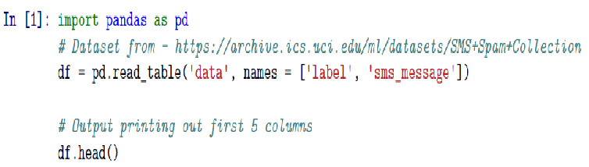
Data Collection
We will be using a dataset from the SpamAssassin 2500 which has a very good collection of datasets for experimental research purposes. The link is SMS Spam Collection Data Set.
Here’s a preview of the data :

Slide 9
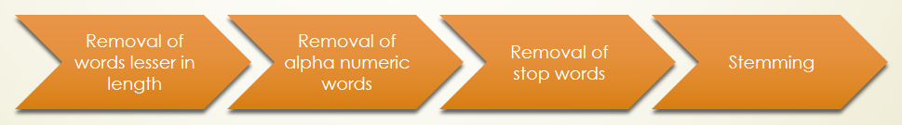
Data Pre-processing
Text Cleaning - Text Cleaning is a very important step in machine learning because your data may contains a lot of noise and unwanted character such as punctuation, white space, numbers, hyperlink and etc.
Some standard procedures that people generally use are:
Convert all letters to lower/upper case.
Removing numbers, punctuation, white spaces, hyperlink.
Removing stop words such as a, about, above, down, doing and the list goes on…
Word Stemming
Word lemmatization

Slide 10
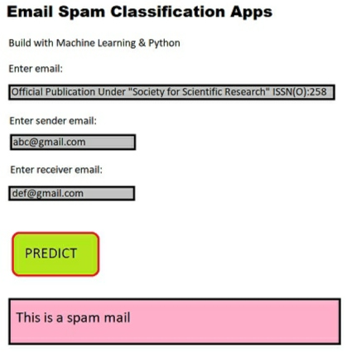
User Interface
Being at an early stage in development the UI is simple.
We have also thought of adding some features to the spam detector such as:
Checking the sender attachment & subject.
We could check for some files like .exe file which are often spam.
In the UI we can import a collection of file by using the Python.

Slide 11
Implementation Issues
One of the drawback of using Naive-Bayes Classification is that if there is no occurrence of a class label and a certain attribute then the frequency based estimation will be zero.
In this early stage we have just developed our spam detection in the shape of detecting only text.

Slide 12
Conclusion
A report has been generated with a detailed explanation of each and every step and algorithm that will be used in the completion of the project.
With the collective effort of all the team member and guidance of our mentor this project of Spam Detection has started to take shape.

Slide 13
References
M.Awad, M.Foqaha Email spam classification using hybrid approach of RBF neural network and particle swarm optimization Int. J. Netw. Secur. Appl., 8 (4) (2016).
D.M. Fonseca, O.H. Fazzion, E.Cunha, I.Las-Casas, P.D. Guedes, W. Meira, M. Chaves.
Measuring characterising, and avoiding spam traffic costs IEEE Int. Comp., 99 (2016).

Slide 14

Thank You

